Slide 1
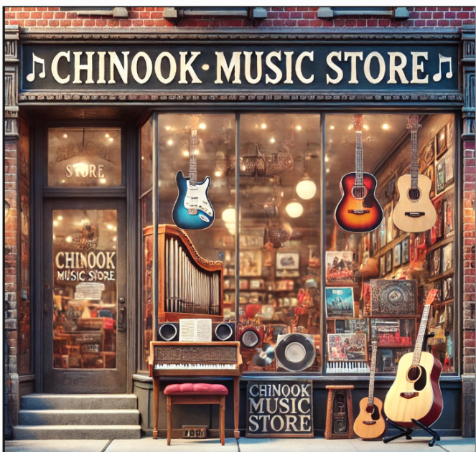
Chinook Music Store Sales analysis
RISHI SRIVASTAVA
12/10/2024

Slide 2

Project Statement
"Unleashing the Power of Data to Amplify Chinook's Melody in the Physical Music Market." As a data analyst at Chinook, the mission is to dive into sales data, uncover actionable insights, and provide data-driven recommendations to help Chinook optimize its performance and captivate a larger audience in the physical music industry.
Objectives
Analyze Sales Trends
Understand Customer Behavior
Optimize Inventory
Maximize Revenue
Expand Markets
“Data That Sings – Turning Numbers into Notes for a Harmonious Strategy!”

Slide 3

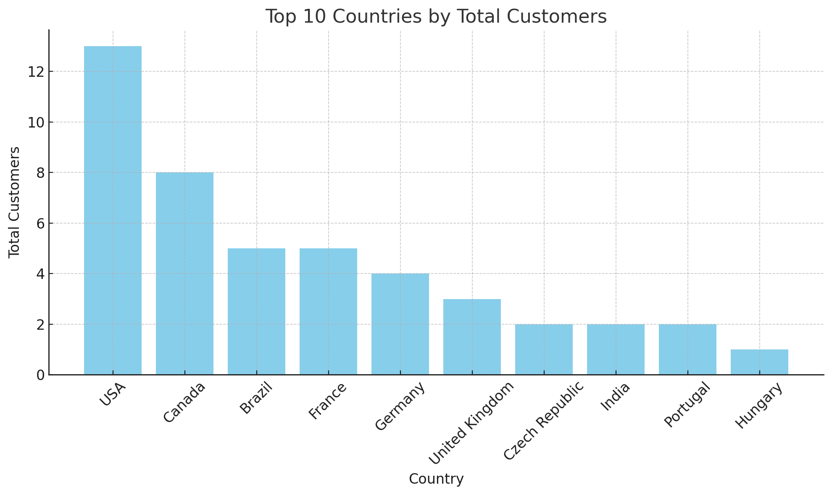
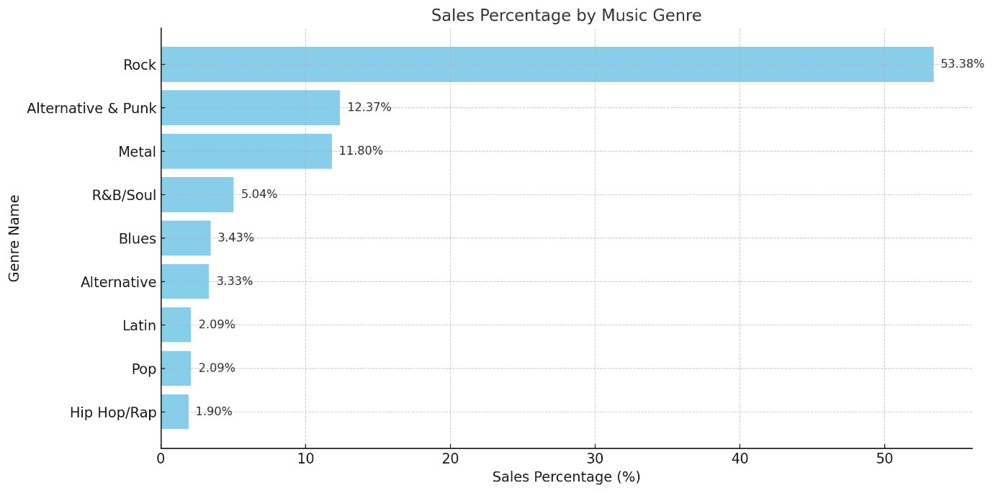
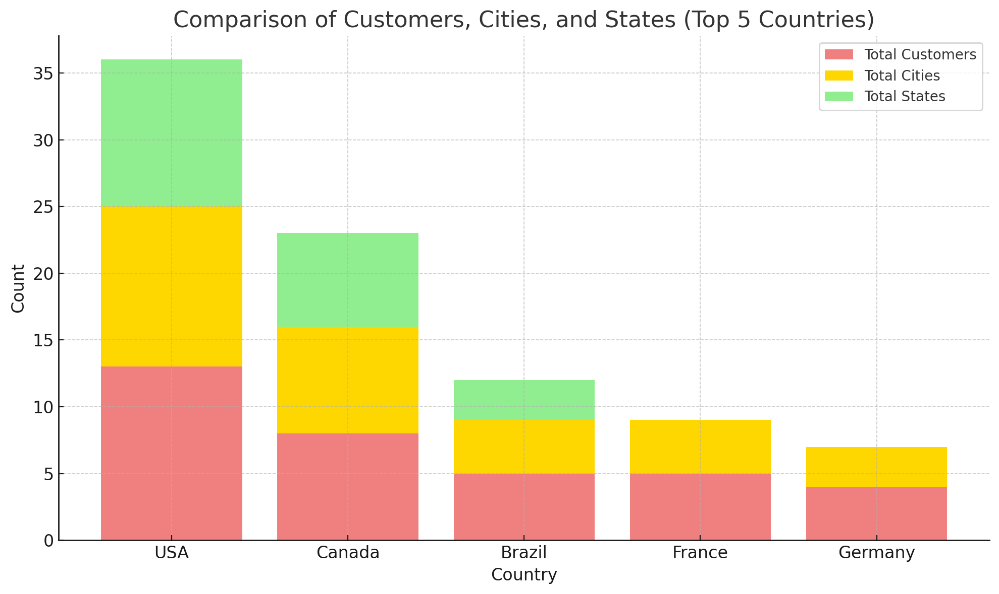
Data Overview

Slide 4

Methodology
Data Cleaning and Preprocessing:
Normalization
Missing Values
Duplicate Records
Data Type Validation
Importance of This Dataset:
Comprehensive dataset for managing a music store.
Supports business decisions
Covers customers, employees, invoices, playlists, and tracks
. Enables insights into sales trends, customer behavior, and music preferences

Slide 5

Analytical Methods and Tools for Chinook's Database
Analytical Methods:
Descriptive Analysis
Objective: Understand sales trends, popular tracks, genres, and artists.
Techniques:
Calculate total revenue and sales by genre, artist, or album.
Analyze customer purchase behavior by region (country/state/city).
Benchmarking
Objective: Compare sales performance with industry standards or similar regions/artists.
Tools
SQL
Use: Extract, manipulate, and analyze data from the Chinook database.
Excel/Google Sheets
Use: Quick analysis and visualization.

Slide 6
.
Analysis of Objective Questions
Total sales contributed by each genre in the USA
Rock: Dominates with 53.38% of total sales
Alternative & Punk: Contributes 12.37%, second most popular
Metal: Accounts for 11.80%, a strong secondary genre
Moderate Sales: R&B/Soul, Blues, and Alternative
Low Contribution: Latin, Pop, and Hip Hop/Rap
Focus Areas: Prioritize top genres while promoting less popular ones strategically.

Slide 7
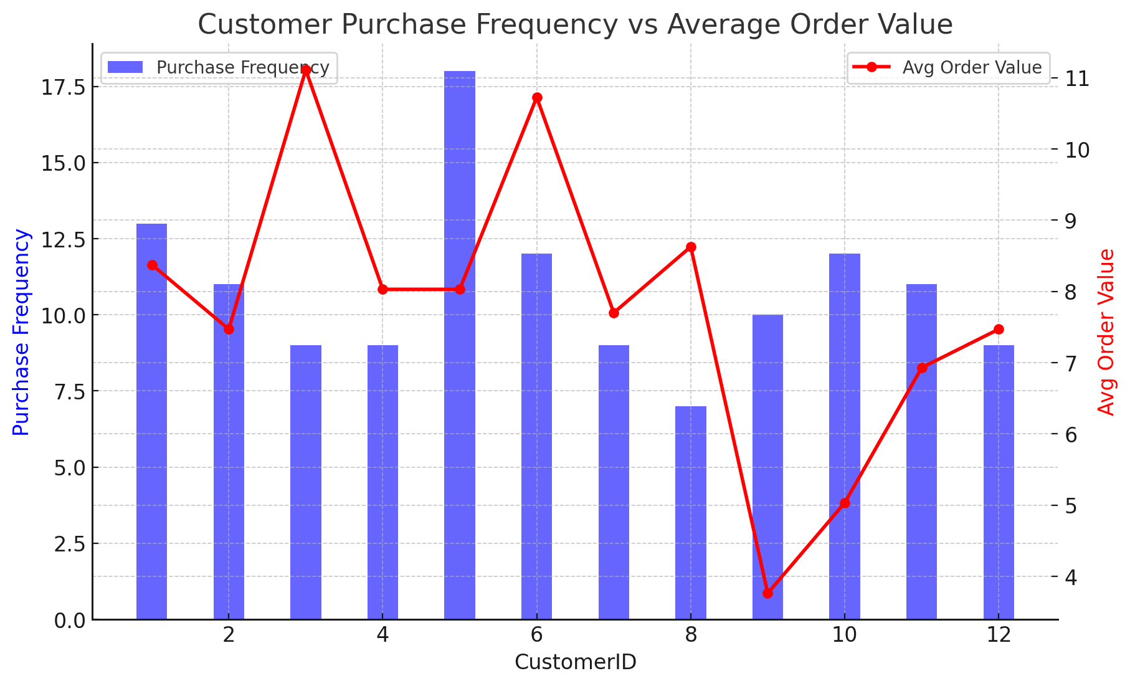
Patterns or Trends in Customer Purchasing Behavior

Slide 8
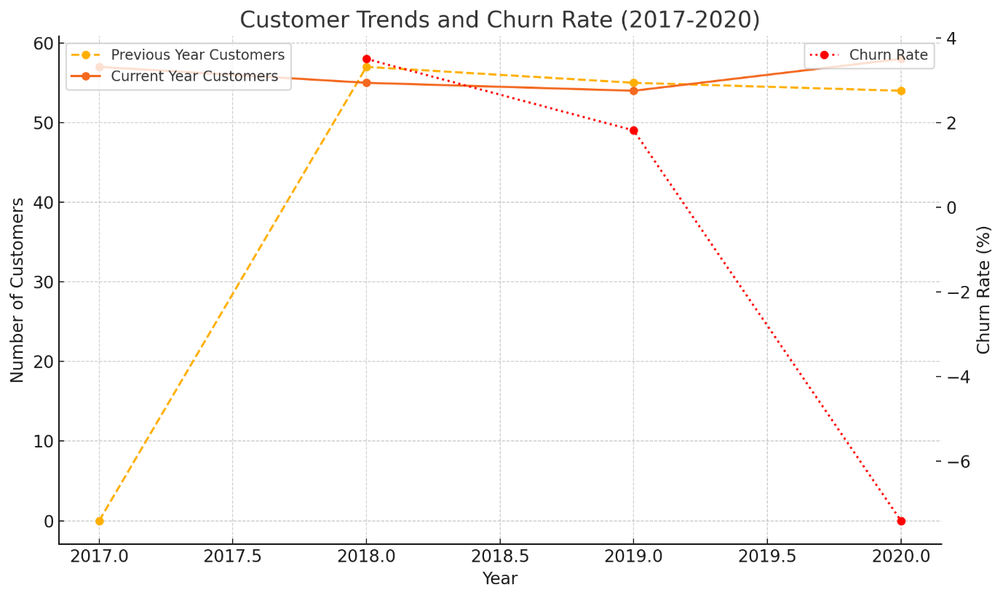
CUSTOMER CHURN RATE
.

Slide 9

Strategic Recommendations
Focus on Top-Selling Genres
Recommendation: Promote genres like Rock (53.38% of sales in the USA).
Promote Top-Selling Artists and Tracks
Recommendation: Center campaigns around top artists like Van Halen.
Re-engage Inactive Customers
Recommendation: Use reactivation campaigns (e.g., discounts, recommendations) for 22 inactive customers.
Use Data-Driven Insights for Campaigns
Recommendation: Track metrics like retention rates and sales growth.
Invest in CLV Analysis
Recommendation: Segment customers by tenure, frequency, and spending.

Slide 10
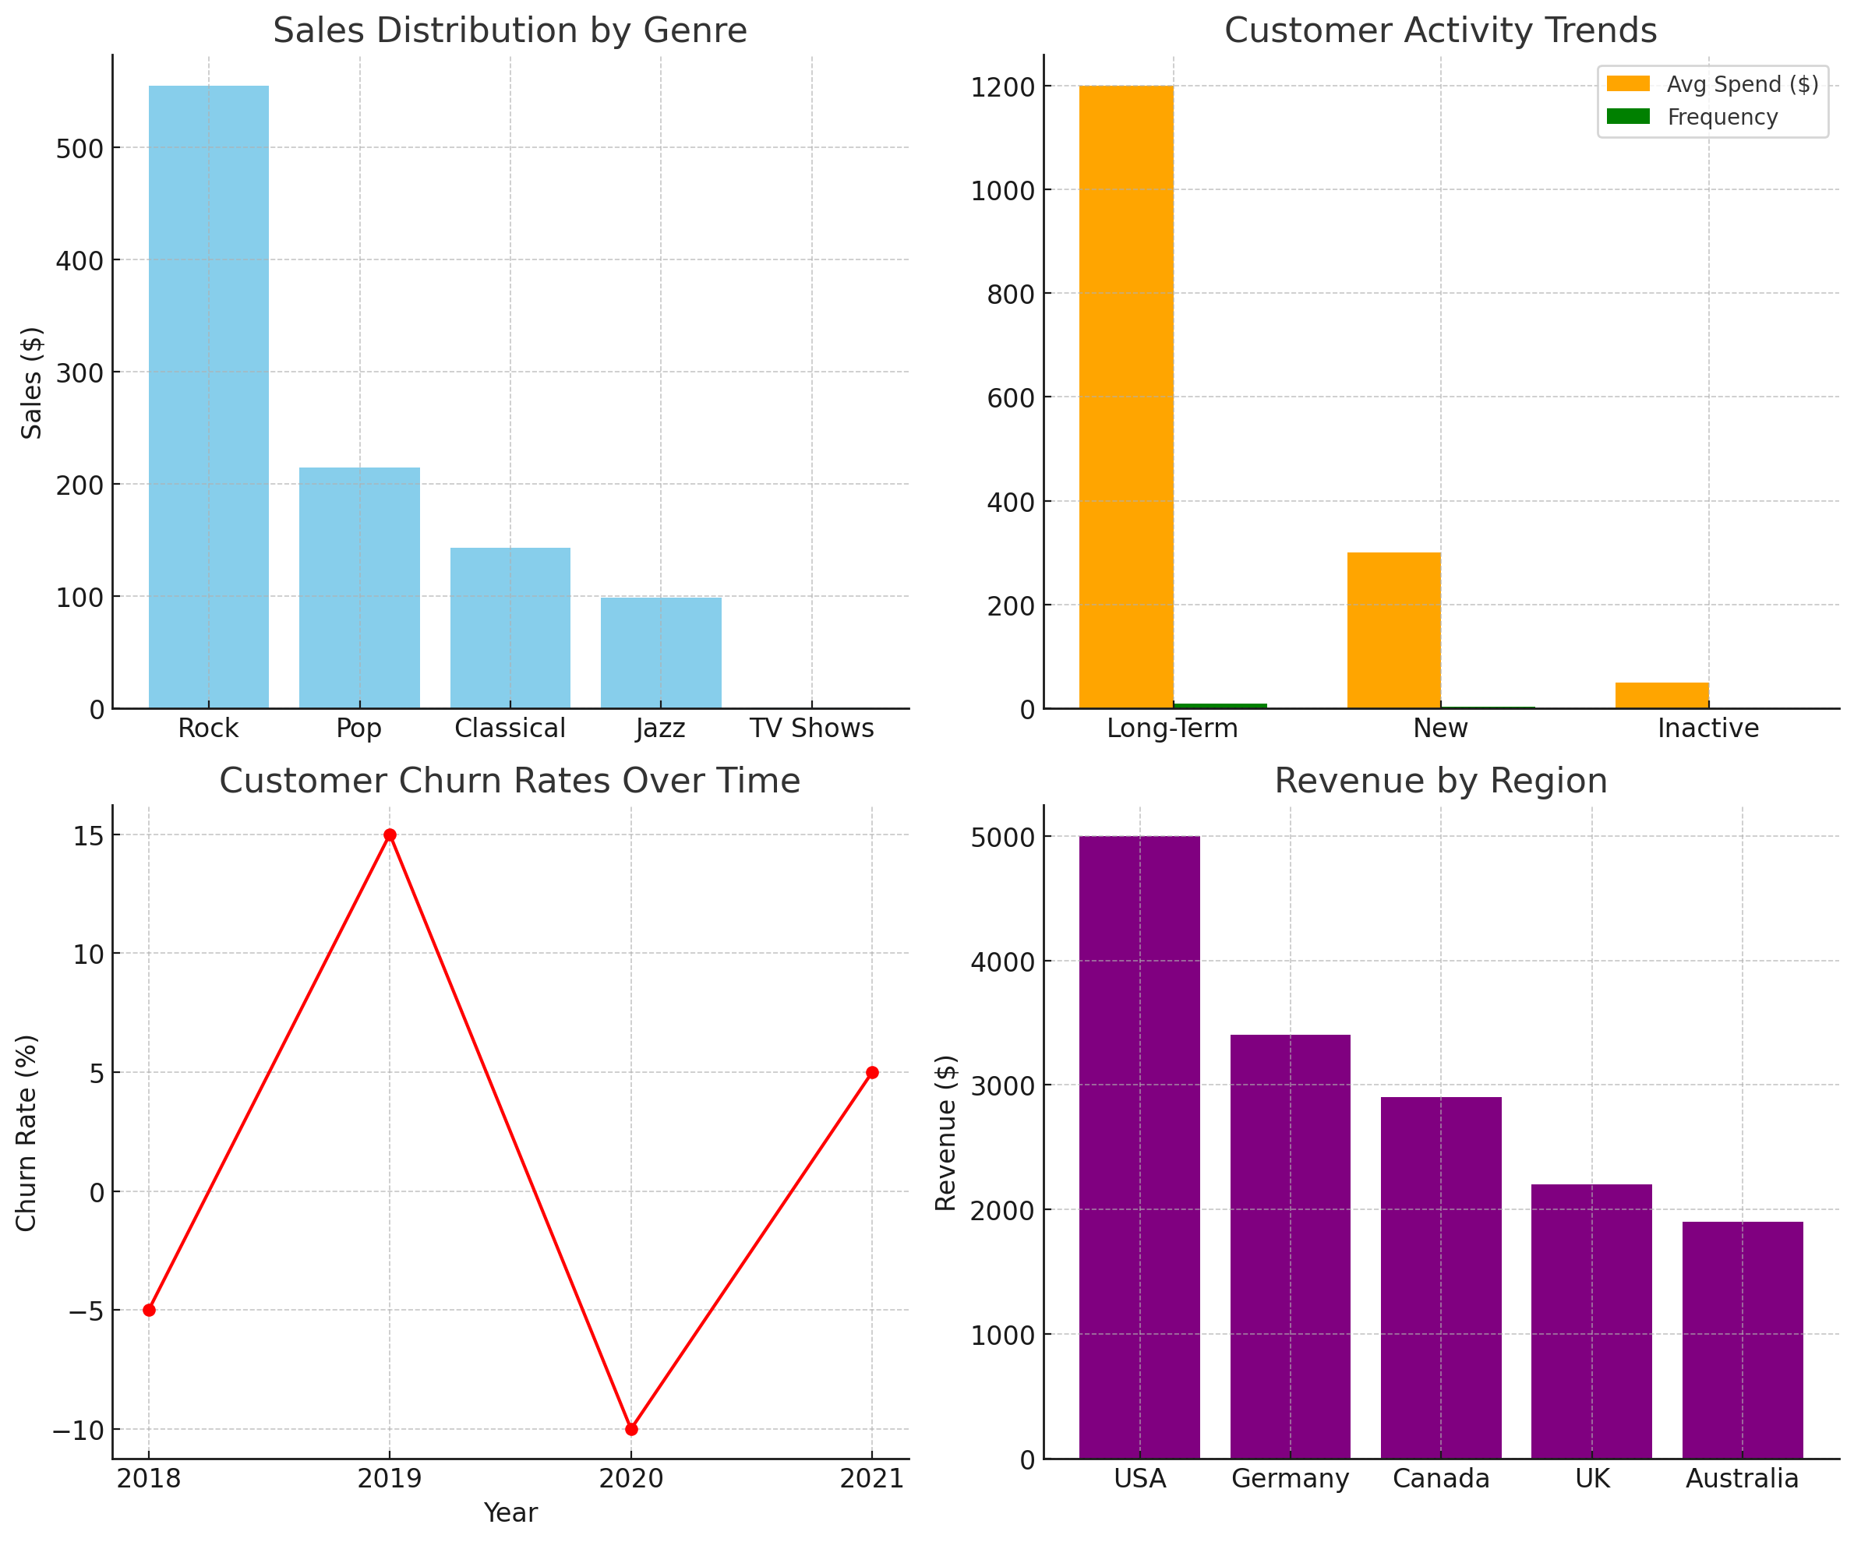
visualization

Slide 11
CONCLUSION
Top Performers
Rock: Dominates globally, with Van Halen leading sales in the USA.
Customer Insights
Loyal Customers: Long-term customers show higher spending and engagement.
Churn Risk: Reactivate high-risk customers with personalized offers.
Regional Dynamics
Global Trends: Rock is universally popular.
Local Preferences: Classical is a standout genre in Germany, enabling localized marketing
Revenue and Sales
Top Region: Czech Republic leads in revenue contribution.
Promotional Campaigns
Impact: Data-driven campaigns enhance acquisition, retention, and sales.
Closing Statement:
Use data-driven insights to drive revenue growth and capture market opportunities.

